Slide 1
Drift alignment using PHD graphs
Trevor Gerdes

Slide 2
Requirements
Auto-guidable telescope
Guidescope
Guide camera that is supported by PHD Guiding
Computer
PHD Guiding loaded onto computer

Slide 3
Normal telescope setup
Level scope
Point south
Set RA adjustment to a centered postiion
Set altitude adjustment to the latitude of your position.

Slide 4
The principles of drift alignment remain the same
Find star on horizon and correct for altitude
Find star at celestial equator/meridian junction and correct for azimuth.

Slide 5
Altitude adjustment
Slew scope to star on horizon
Start PHD and find star on your computer screen.
Star does not need to be centered, does not need to be bright. Just a normal “guide star”
Click on star
Tell PHD to guide on star
PHD will now run through its calibration routine to determine which way is N/S/E/W and what the pixel scale for movement is.

Slide 6
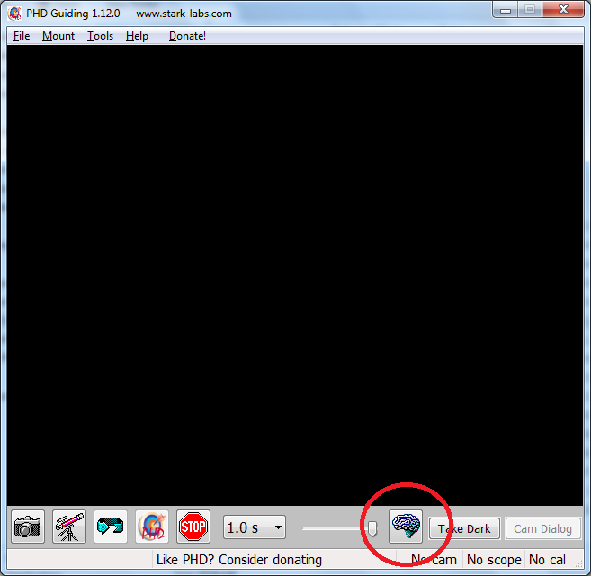
Stop guiding
Click on the Brain

Slide 7
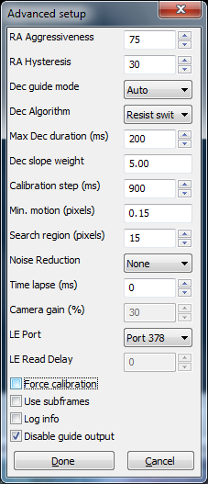
Click on Disable guide output

Slide 8
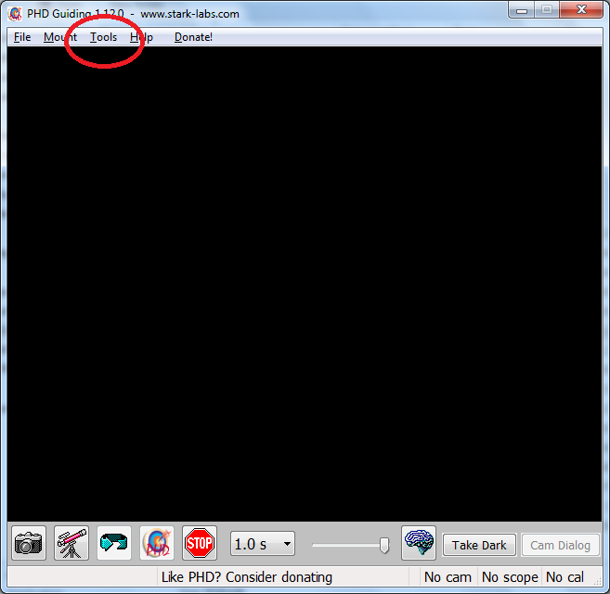
Select “Tools” from main window

Slide 9
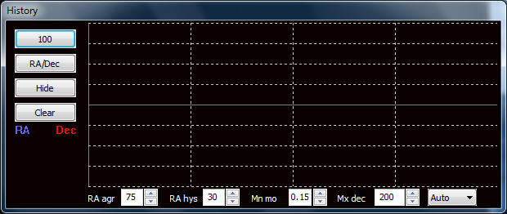
Select Enable Graph

Slide 10
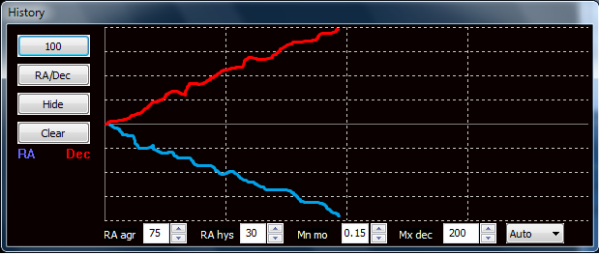
Back to main window
Select any star on screen
Select guide button.
Switch window back to graph screen
Watch direction of star drift with Red line only (DEC), do not worry about the blue line.

Slide 11
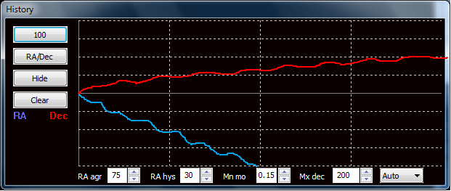
Stop guiding
Move altitude adjustment 1 degree in any direction and repeat previous procedure.
Watch slope of redline drift, did it get sleeper shallower or swap direction up/down.
This will tell you which way and by how much your next move is.

Slide 12

Keep re-iterating this procedure until you have a flat line.
You should be able to re-iterate every 1 min if not less in the initial stages.
Remember, each horizontal dotted line in the graph window is 1 pixel of movement.

Slide 13
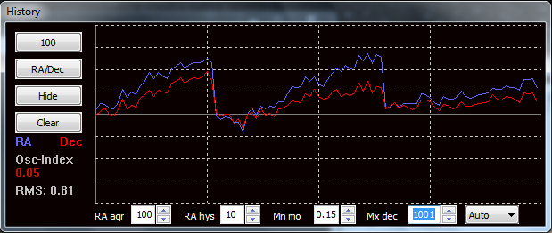
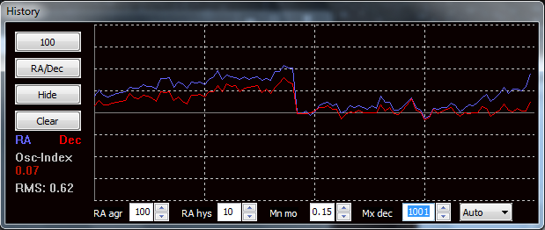
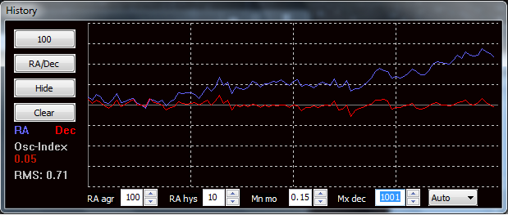

Slide 14
Azimuth adjustment
Slew to star on the celestial equator/meridian junction.
Repeat process for Altitude adjustment except for the initial calibration routine (PHD already knows which way is up)
Remember , this time we are adjusting our azimuth controls, not our altitude controls.
Again, we are still looking at our red DEC line only.

Slide 15
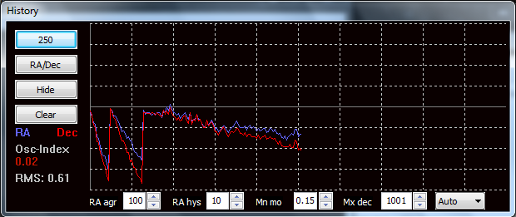
Select and guide on star
Watch star drift above or below line.
Stop guiding.
Adjust azimuth to far maximum east or west
Select new guide star and watch for drift.
Check drift slope did it increase, decrease or reverse direction.

Slide 16
If slope decreased, then you are heading in the right direction but you are still not pointing far enough south. Adjust your azimuth controls on the mount to point further south and try again.
It slope reversed, then you know that south is somewhere between where you are now and where you started. Again adjust azimuth in the reverse direction half of what you previously adjusted and try again.
If slope increased then you know that south is on the other side of the half way mark.
Adjust appropriately and re-iterate.

Slide 17

Our Goal

Slide 18
After one complete adjustment iteration of alignment for Altitude and Azimuth and you can get your star is tracking within 1-2 pixels (depending on your mounts PEC) for 1 minute, then you are good to go for guided exposures up to about 5-10 minutes before field rotation becomes noticeable
If you run through the process again and fine tune your alignment, you should see further improvements and unguided star tracking of 1-2 pixels for 3 minutes should mean you can run 15-20 minute guided exposures before field rotation becomes noticeable.

Slide 19
Questions ?

